Slide 1
Programming for Engineering 2
Week 14 : Final Presentation
PC
Information of team
x
Team
A2
Member1 : Seo Jinchan
Member2 : Kim Chanyoung
Member3 : Jose Alan Barraza Villaverde
OK

Slide 2
What is the problem?
Explanation of our team project
Process and results of the program
Let’s watch it together
(Launch the program)

Slide 3
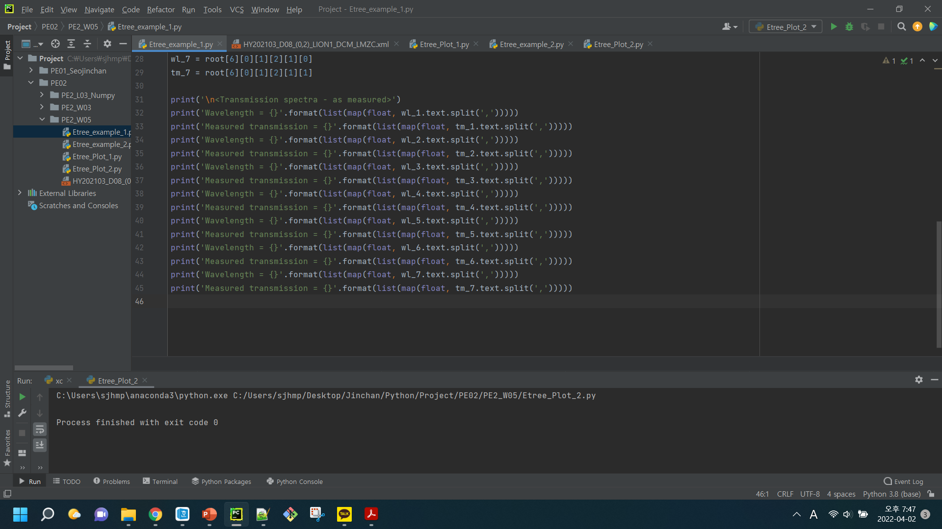




What is the mission?
What is the problem?
x
What is the problem?
Explanation of our team project
Process and results of the program
Many raw data
+
Detail condition (wafer number..)
Let’s watch it together
Customer
Company
Results as png, xlsx file

Slide 4
What is the mission?
What is the problem?
x
What is the problem?
Explanation of our team project
Process and results of the program
Let’s watch it together
So, we made a python project
to analyze measured data of wafers.
It can plot and save graphs for any data they want,
and also save xlsx files.

Slide 5
What is the mission?
Explanation of our team project
x
What is the problem?
Explanation of our team project
Process and results of the program
Module Diagram
Let’s watch it together
filter
total_plot
Create_folder
IV_plot
Tm_plot
Create_folder
save_xlsx
extract
Tm_data
IV_data
error

Slide 6
What is the mission?
Explanation of our team project
x
What is the problem?
Explanation of our team project
Module Diagram
Process and results of the program
Create_folder
Let’s watch it together
IV_plot
total_plot
Tm_plot
filter
get_result
run.py
Create_folder
extract
IV_data
save_xlsx
Tm_data
error

Slide 7
What is the mission?
Explanation of our team project
x
What is the problem?
Explanation of our team project
Process and results of the program
Let’s watch it together
.gitignore
/dat/D* : raw data /src/__pycache__ : cache files
/res/png_files/2* , /res/xlsx_files/2* : result data

Slide 8
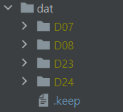
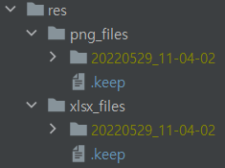
What is the mission?
Explanation of our team project
x
What is the problem?
Explanation of our team project
.gitignore
Process and results of the program
/dat/D* : raw data /src/__pycache__ : cache files
/res/png_files/2* , /res/xlsx_files/2* : result data
Let’s watch it together
But, we made dummy file ‘.keep’,
and then remain ‘dat’ & ‘res’ folders

Slide 9
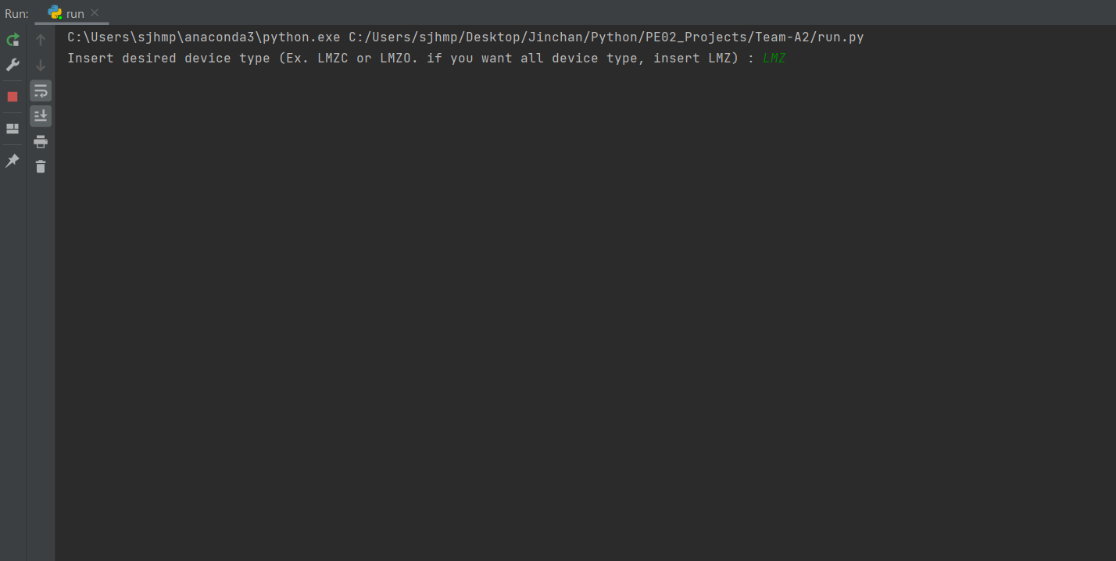
What is the mission?
Process and result of the program
x
What is the problem?
Explanation of our team project
Process and results of the program
Let’s watch it together

Slide 10
What is the mission?
Process and result of the program
x
What is the problem?
Explanation of our team project
Process and results of the program
Let’s watch it together

Slide 11
What is the mission?
Process and result of the program
x
What is the problem?
Explanation of our team project
Process and results of the program
Let’s watch it together

Slide 12
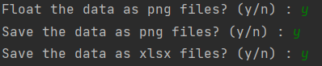
What is the mission?
Process and result of the program
x
What is the problem?
Explanation of our team project
Process and results of the program
Let’s watch it together

Slide 13
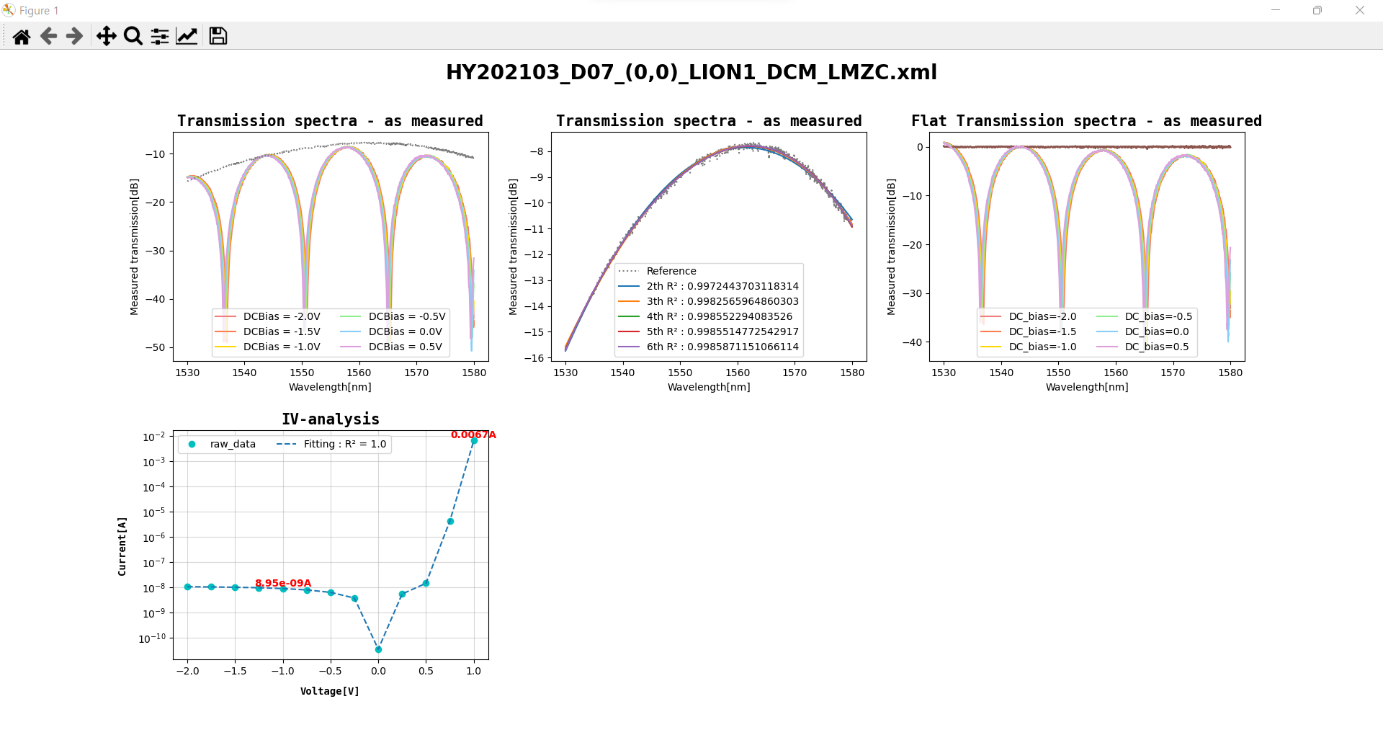
What is the mission?
Process and result of the program
x
What is the problem?
Explanation of our team project
Process and results of the program
Let’s watch it together
Remaining time
Progress
Progress time
Transmission rate

Slide 14
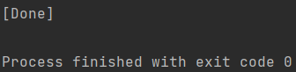
What is the mission?
Process and result of the program
x
What is the problem?
Explanation of our team project
Process and results of the program
Let’s watch it together

Slide 15
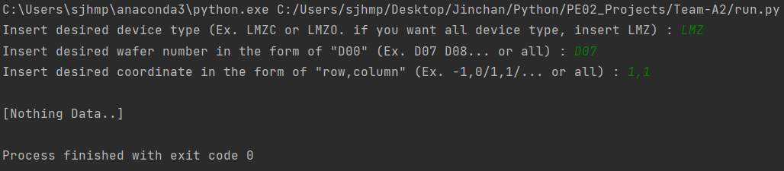
What is the mission?
Process and result of the program
x
What is the problem?
Explanation of our team project
Process and results of the program
Let’s watch it together
If there is no data, the error is printed
and the operation is stopped.

Slide 16
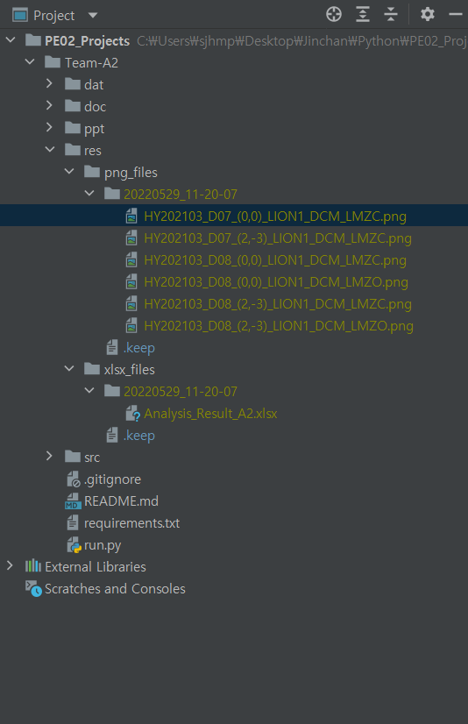
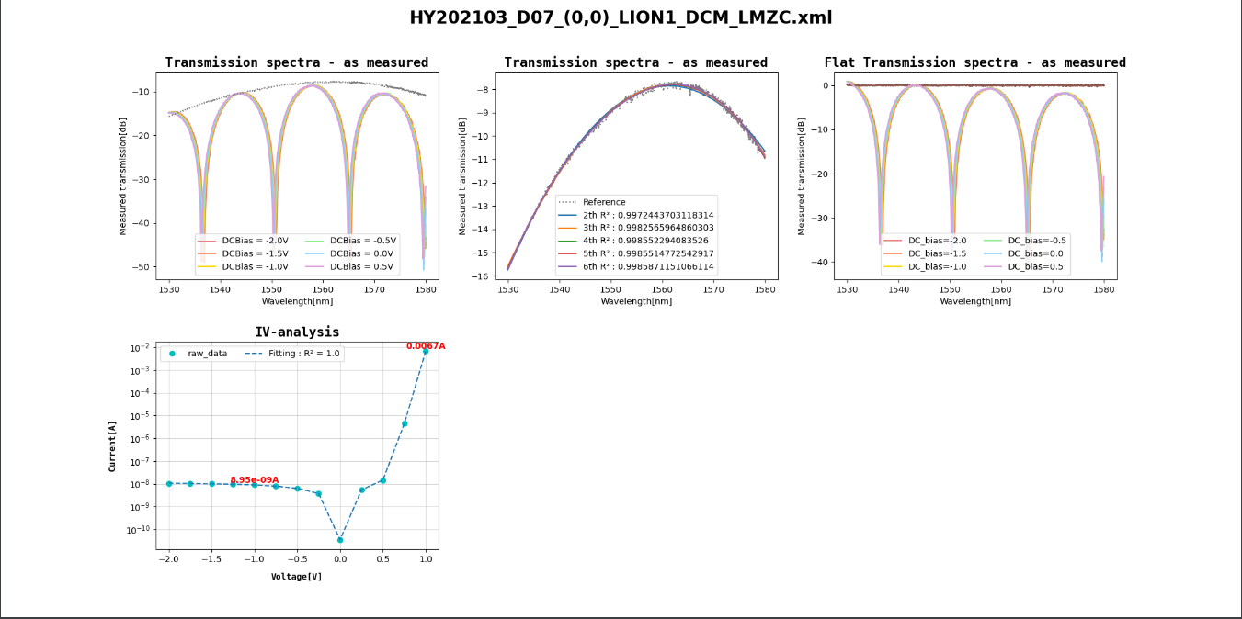
What is the mission?
Process and result of the program
x
What is the problem?
Explanation of our team project
Process and results of the program
Date created
Let’s watch it together

Slide 17
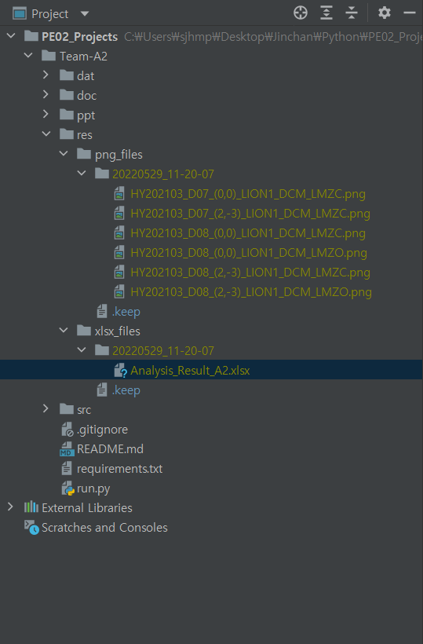
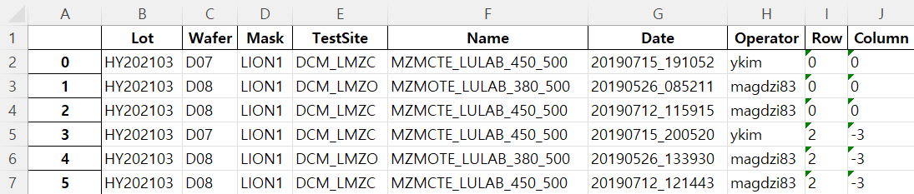
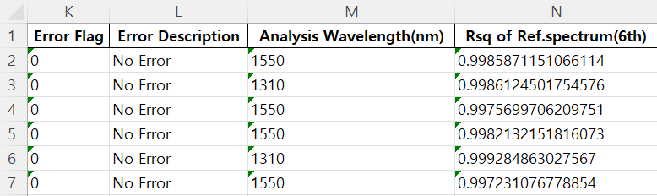
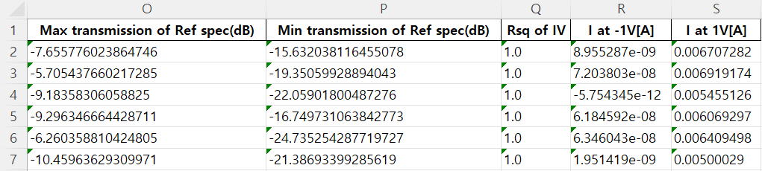
What is the mission?
Process and result of the program
x
What is the problem?
Explanation of our team project
Process and results of the program
Let’s watch it together

Slide 18
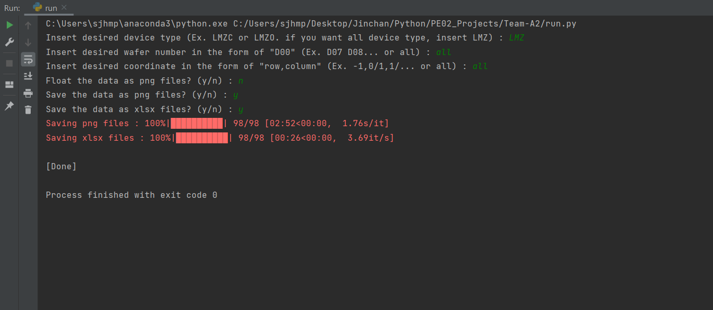
What is the mission?
Process and result of the program
x
What is the problem?
Explanation of our team project
Process and results of the program
Let’s watch it together
When the program process all files,
the total running time is about 3 minutes.

Slide 19
What is the mission?
Let’s watch it together
x
What is the problem?
Explanation of our team project
Process and results of the program
Let’s watch it together

Slide 20
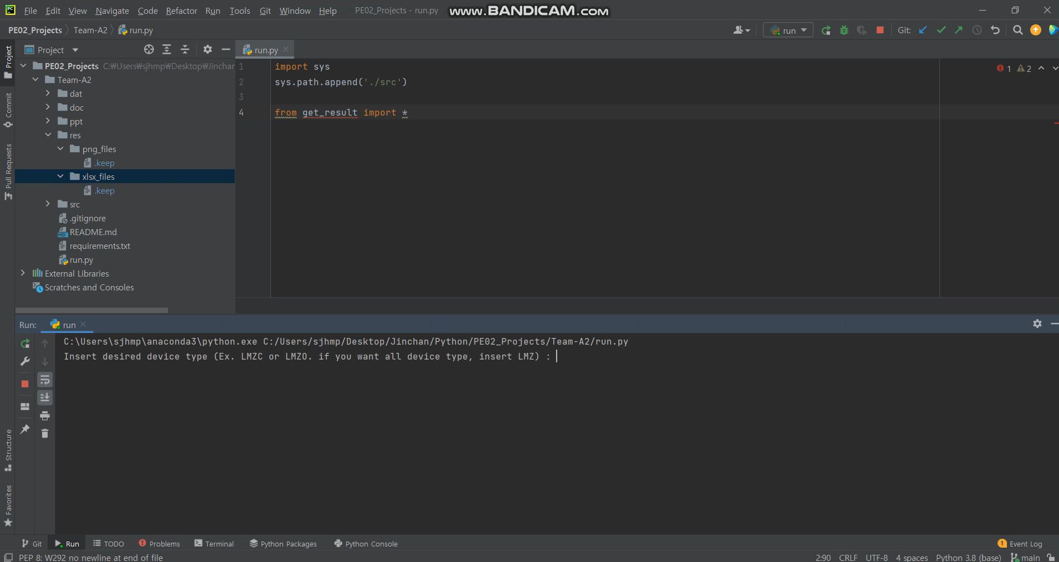

Slide 21
Thank you for listening

